Slide 1
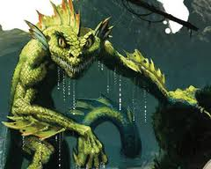
COSC 310: Software Engineering SURVIVOR
By Drew Ingram
Presentation: 30/11/2012

Slide 2
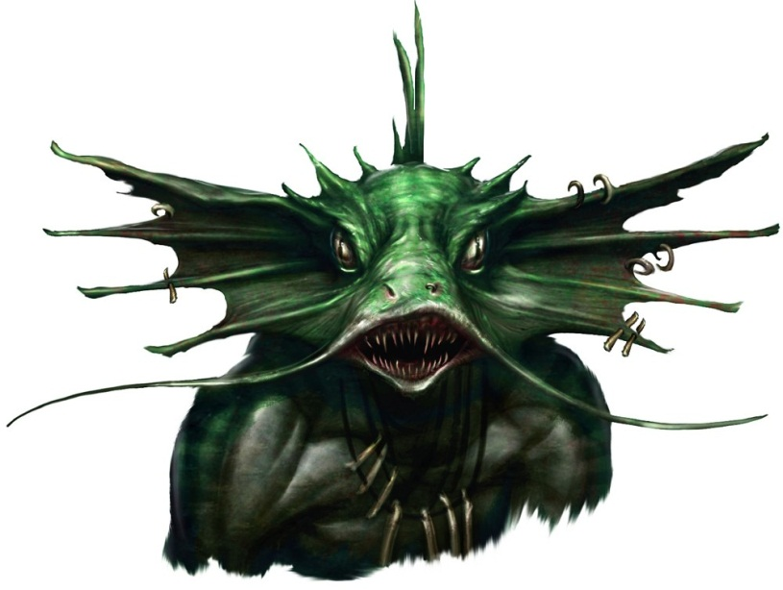
Topic:
Edwin, an acquaintance of the user, claims that he has escaped from a group of sahuagins
The user can talk to him about his ordeal

Slide 3

How it works
The program has eight states, including a super state and an initial state
States: “Belief”, “Disbelief”, “crazy”, “lying”, “help”, “comfort”
Each state has different outputs which it determines in its own code

Slide 4
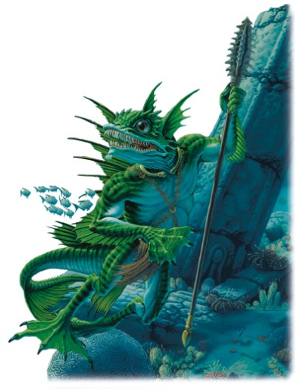
Key Words
Negations: “don’t”, “can’t”, “not” etc.
Inquiries: “what”, “why”, “when” etc.
State changing key words: “Crazy”, “nuts”, “pshychiatrist”, “mental” make it go to “crazy” state.
“Full” is an interesting one, goes from belief to disbelief

Slide 5
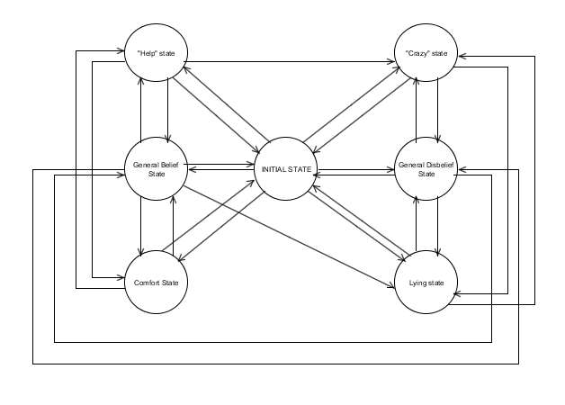
State Diagram

Slide 6
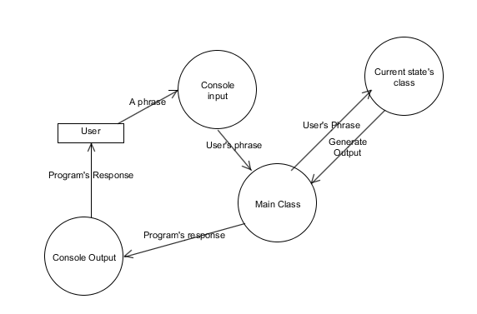
Dataflow Diagram

Slide 7
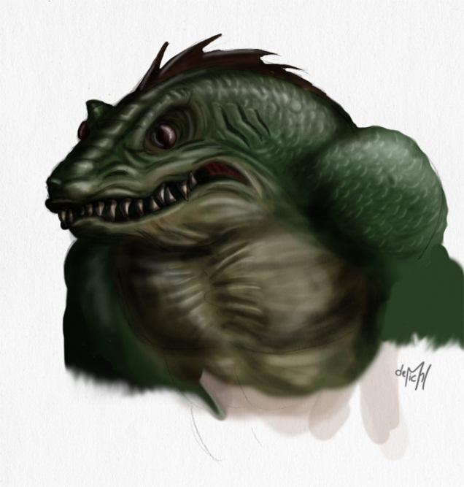
A sample convo where things went well
Hey. I'm guessing you already heard...a few days ago I was attacked by a bunch of...well, the best way I can describe them is "sahuagins".
Oh really?
I guess you believe me then.
Actually, I think are full of dancing pandas
I guess you don't believe me then.
Why were you there?
I was just relaxing. It's been a busy week.
What did these things look like?
Look, I don't know if that's what they were really called. I looked the description up
online and this is what I found.
What did they look like though?
They looked like fish men. They were ugly, green scaly and had fins everywhere.
They were an making that incessant hissing noise
Okay, I believe you.
I guess you believe me then.
Were you hurt?
It was a pretty close call but I'm fine now. They didn't touch me.
You know, these creatures may be dangerous
You're right. Somebody could get seriously hurt.
We should do something
Something definitely needs to be done. Of course, the're's not a heck of a lot we can do when
when nobody believes us
maybe we are just crazy
Well that's just great. You hear what I have to say and just assume I've gone bonkers.
or maybe you're lying
I'm not lying!

Slide 8
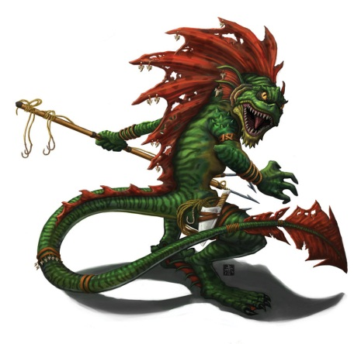
A really bad one…
Edwin: I guess you believe me then.
User: no youre crazy
Edwin: Well that's just great. You hear what I have to say and just assume I've gone bonkers.
User: yes you have
Edwin: You think I'm Crazy??
User: yes
Edwin: You think I'm Crazy??
User: god damn it yes
Edwin: You think I'm Crazy??
User: yes
Edwin: You think I'm Crazy??
User: youre crazy
Edwin: Well that's just great. You hear what I have to say and just assume I've gone bonkers.
User: kill me now
Edwin: You think I'm Crazy??
User: no
Edwin: You think I'm Crazy??
User: as a friend yes

Slide 9
Different Outputs for different states:
Edwin: Hey. I'm guessing you already heard...a few days ago I was attacked by a bunch of...well, the best way I can describe them is "sahuagins".
User: How did you escape?
Edwin: Basically I just ran. They were pretty clumsy out of water.
Edwin: Hey. I'm guessing you already heard...a few days ago I was attacked by a bunch of...well, the best way I can describe them is "sahuagins".
User: You are full of obese chickens.
Edwin: I guess you don't believe me then.
User: How did you escape?
Edwin: I ran like hell! I think they tried to catch me, but...I don't know, maybe they just aren't very fast on land and it was like, ten degrees below zero so that might have slowed them down

Slide 10
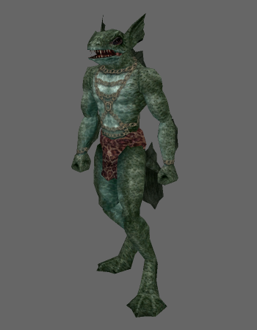
SDLC
Started doing waterfall, hated it
Went with an agile approach
Next time, I would have done more planning and interviewed more people early on to find out what they would say to my program

Slide 11
Challenges & Rewards:
Challenges…
Waited too long to start coding
Much of the planning I did initially was scrapped
Ended up not planning enough, making my code very messy
Should have used a database
It is very difficult to come with outputs that make sense and keep the user on track
Rewards…
It was fun to see my program work (which was not very often)
I now have a better idea of how to handle projects like this

Slide 12
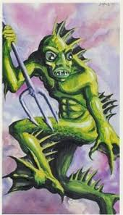
Questions?
Do you folks have any questions?

